Slide 1
Molecular Genetics, Risk Aversion, Return Perceptions, and Stock Market Participation
Rick Sias Laura Starks Harry Turtle
University of Arizona University of Texas Colorado State University
Rodney White Conference on Financial Decisions and Asset Markets
March 2019

Slide 2
Motivation –
Do genetic factors impact:
Risk aversion?
Beliefs regarding the distribution of equity returns?
Stock market participation?
Importance of genetic factors
Linking risk aversion and beliefs to stock ownership
Linking other factors (e.g., wealth, trust) to stock ownership, risk aversion, and beliefs

Slide 3
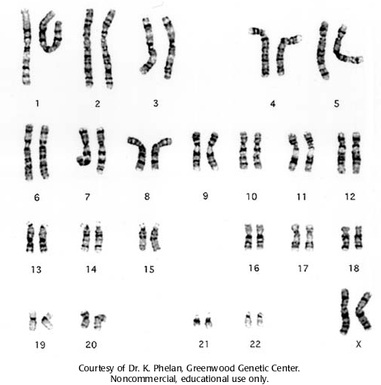
Molecular genetics
Genome – genetic information needed to build and maintain a human
Contained in 23 pairs of chromosomes within every* cell in your body

Slide 4
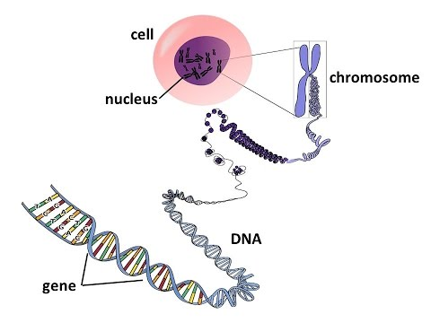
Molecular genetics
Each chromosome is one long DNA molecule
Genes are the parts of the DNA that “code” for protein
99% of DNA is non-coding
“Rungs” of the DNA ladder consist of four nitrogenous bases
A (adenine)
T (thymine)
C (cytosine)
G (guanine)
Notes:
37T cells

Slide 5
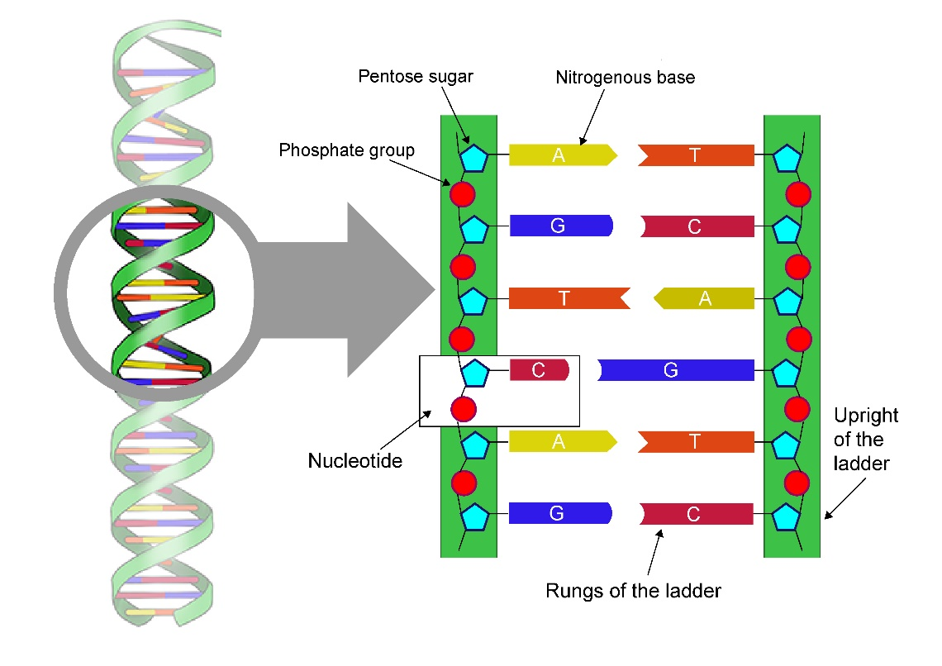
Molecular genetics
Complementary base pairing (A&T; C&G)
Human genome (i.e., the 23 chromosomes) have 3.2B “rungs” (base pairs)

Slide 6
Molecular genetics
Nucleotide is the side of the ladder + the associated Nitrogenous base (e.g., highlighted nucleotide is C)
Of 3.2B base pairs, <1% vary across individuals which accounts for why we are not identical*

Slide 7
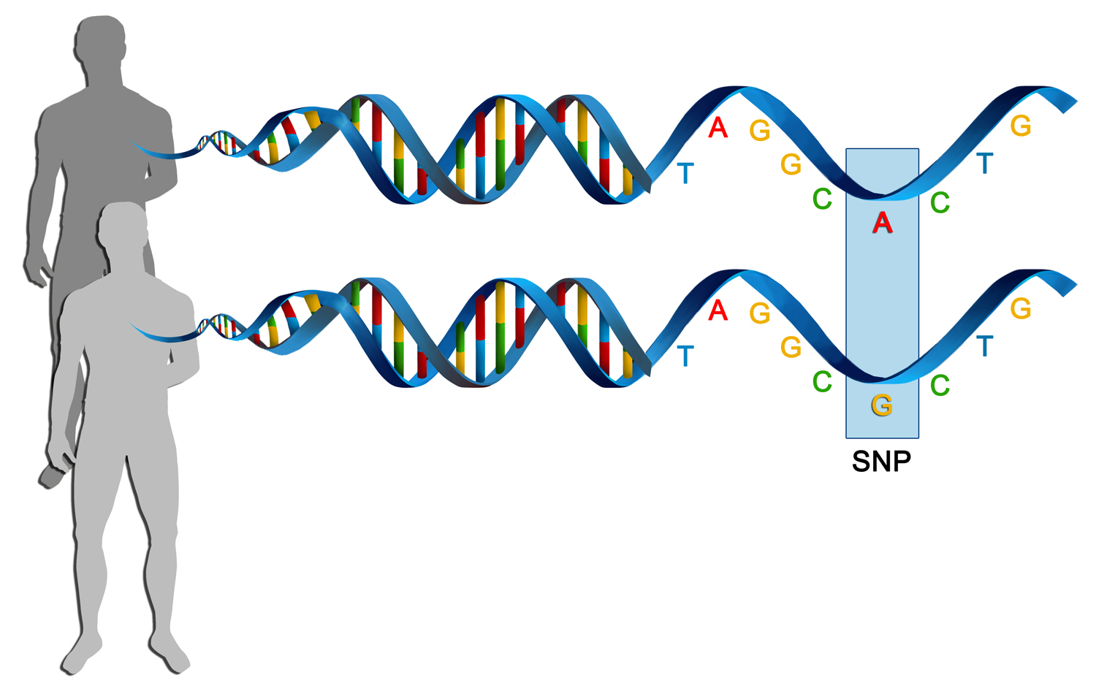
Molecular genetics
Places where two individuals differ are Single Nucleotide Variation
If <1% of population differs, SNV=mutation
If >1% of population differs, Single Nucleotide Polymorphism (SNP)
~10M SNPs

Slide 8
Molecular genetics
Once human genome mapped, look for relations between SNPs (places where the “rungs” differ) and characteristics -- physical, disease, behavioral
Few characteristics are due to a single (or even few) SNPs
Sickle cell anemia due to a single SNP (Mendelian trait)
Most characteristics are impacted by many SNPs
E.g., hundreds or thousands of SNPs make very small contributions to height
Notes:
Mendelian trait = monogenetic trait
Multiple SNPs ==> polygenic trait

Slide 9
Molecular genetics
Standard approach: Genome Wide Association Studies (GWAS)
Search the entire genome (~all 10M SNPs in 23 chromosomes)
Because #potential independent variables >>observations
➔regress phenotype on each SNP individually (and controls), e.g., 10M regressions
Weight SNPs by effect size to form a single measure known as PolyGenic Score (PGS)
Notes:
Polygenic score == risk factor for a phenotype == likelihood of a particular trait

Slide 10
Data
Health Retirement Study (SSA and National Institute on Aging)
Adults ages 50-80
Our sample
Surveys for 2010, 2012, 2014, & 2016
>6k individuals and >13k individual-year observations

Slide 11
Data
Educational Attainment PGS
General Cognition PGS
Neuroticism PGS
Depressive Symptoms PGS
Myocardial Infarction PGS
Coronary Artery Disease PGS
BMI PGS
Height PGS
Genetics
Outcomes
Self-rated risk aversion
Chance market up (>0)
P(R_{M}>20%)
P(R_{M}<-20%)
Hold any stocks
Traditional explanatory variables
Wealth
Income
Education
Cognition
Trust
Sociability
Optimism
Early life poverty
Height
BMI
Health
Controls
Gender
Age
HRS Wave
Retired
Married
Genetic PCs
Notes:
Panel C of Appendix A provides a summary of studies describing links between traditional explanatory variables and outcomes

Slide 12
Genetics, holding stocks, risk aversion, and beliefs
Q1 - Do genetic endowments help explain variation in risk aversion, beliefs regarding stock returns, and stock market participation?
Regress outcomes on controls and each PGS

Slide 13
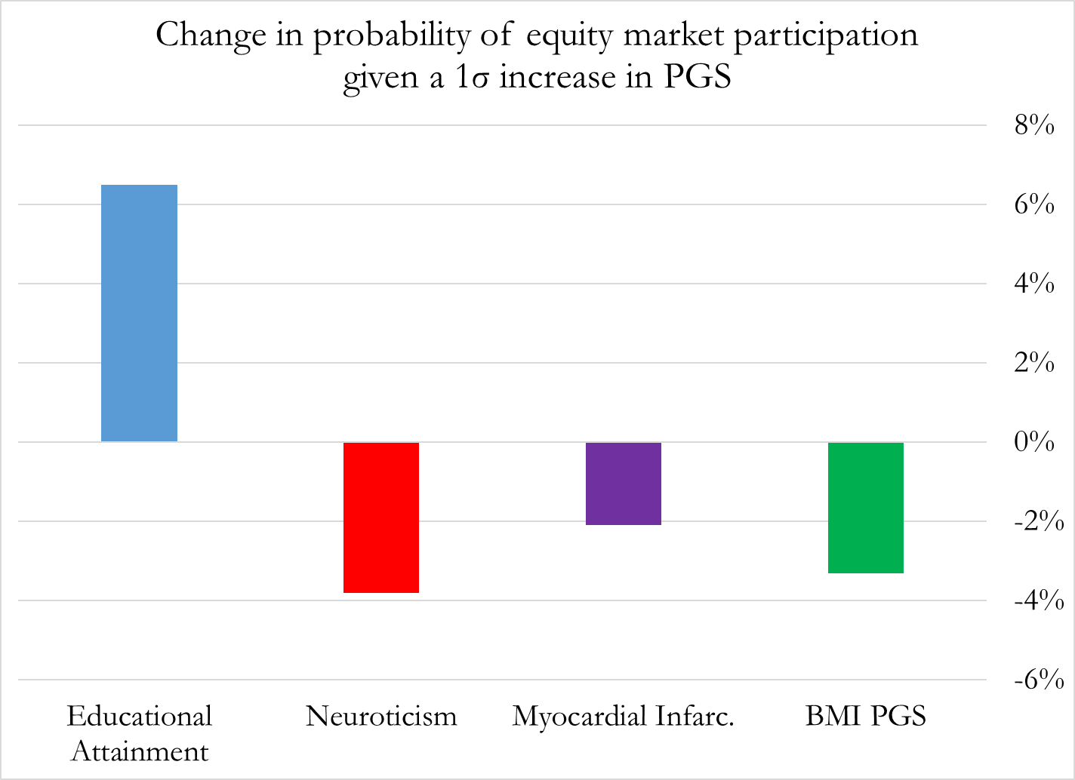
Genetics and likelihood of holding any stock

Slide 14
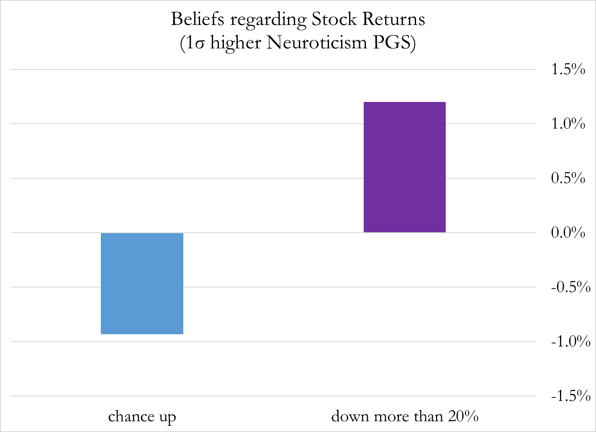
Genetics and beliefs regarding stock returns
Notes:
~4% in std dev terms
Std dev of chance up is 26.5% ➔ 0.927/26.5 = 3.5%
Std dev of crash is 23.198 ➔ 1.021/23.2 = 4.4%

Slide 15
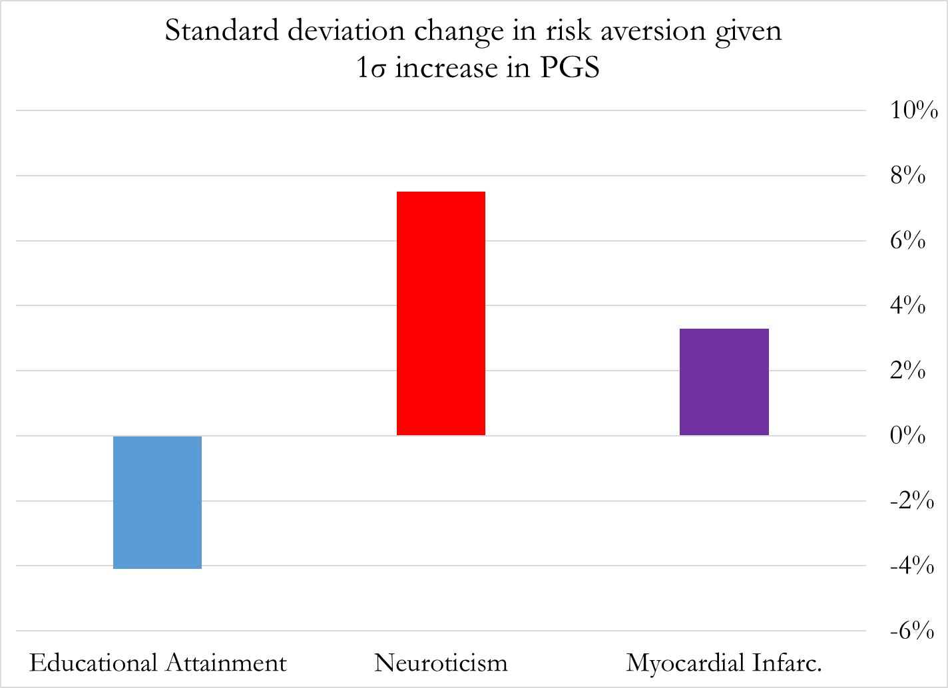
Genetics and risk aversion

Slide 16
Genetics, holding stocks, risk aversion, and beliefs
Q1 - Do genetic endowments help explain variation in risk aversion, beliefs regarding stock returns, and stock market participation?
Yes

Slide 17
Genetics, holding stocks, risk aversion, and beliefs
Q2 – Can genetics help explain the relation between risk aversion, beliefs, and stock market participation? And, if so, how much?
Step 1: Remove variation in participation, risk aversion, and beliefs related to control variables (e.g., age, gender, married, retired, HRS waves, & genetic PCs)
“Orthogonalized” participation, risk aversion, beliefs
Step 2: Regress orthogonalized RA (or beliefs) on the eight PGSs
➔fitted value is “genetic component”
➔residual is “non-genetic component”
Step 3: Regress orthogonalized participation on genetic and non-genetic components and partition R²

Slide 18
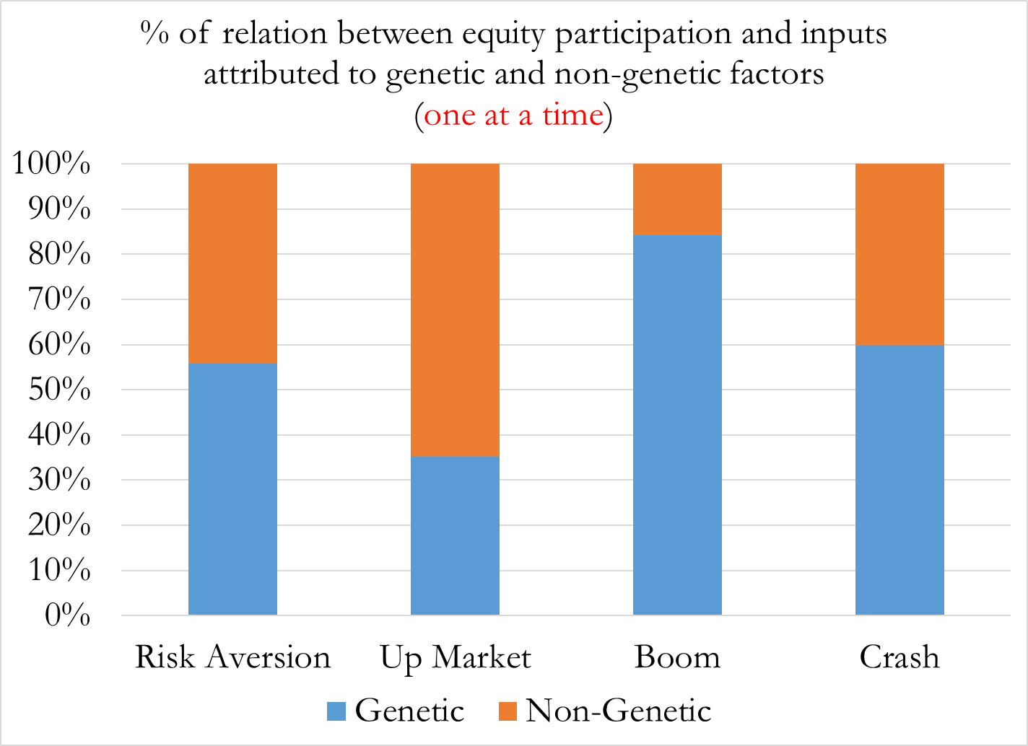
Stock market participation, risk aversion, and beliefs

Slide 19
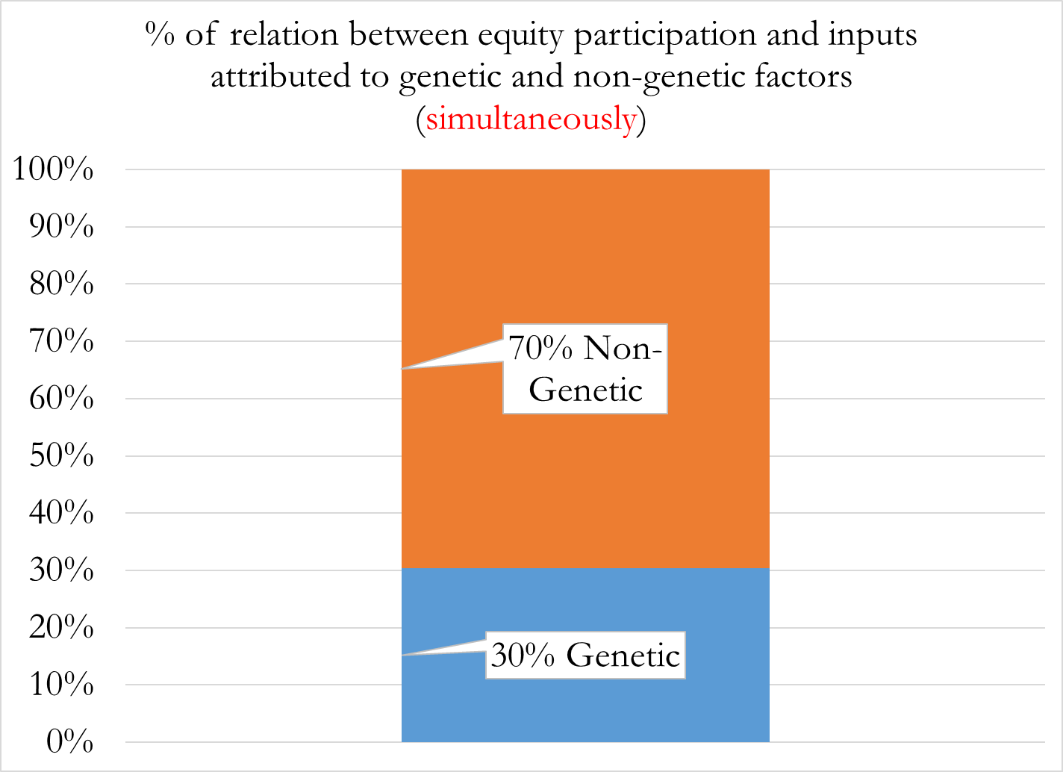
Stock market participation, risk aversion, and beliefs

Slide 20
Traditional explanatory variables and genetics
Q2 – Can genetics help explain the relation between risk aversion, beliefs, and stock market participation? And, if so, how much?
Yes
Best estimate: 30% genetic/70% non-genetic

Slide 21
Traditional explanatory variables and genetics
Q3a – Can genetics help explain the relation between “traditional” explanatory variables stock market participation, risk aversion, and beliefs?
Step 1: Confirm relation between traditional variables (e.g., trust) and stock market participation
Higher trust➔lower risk aversion, more bullish beliefs, and greater equity market participation
Step 2: Test if genetics help explain variation in traditional variables

Slide 22
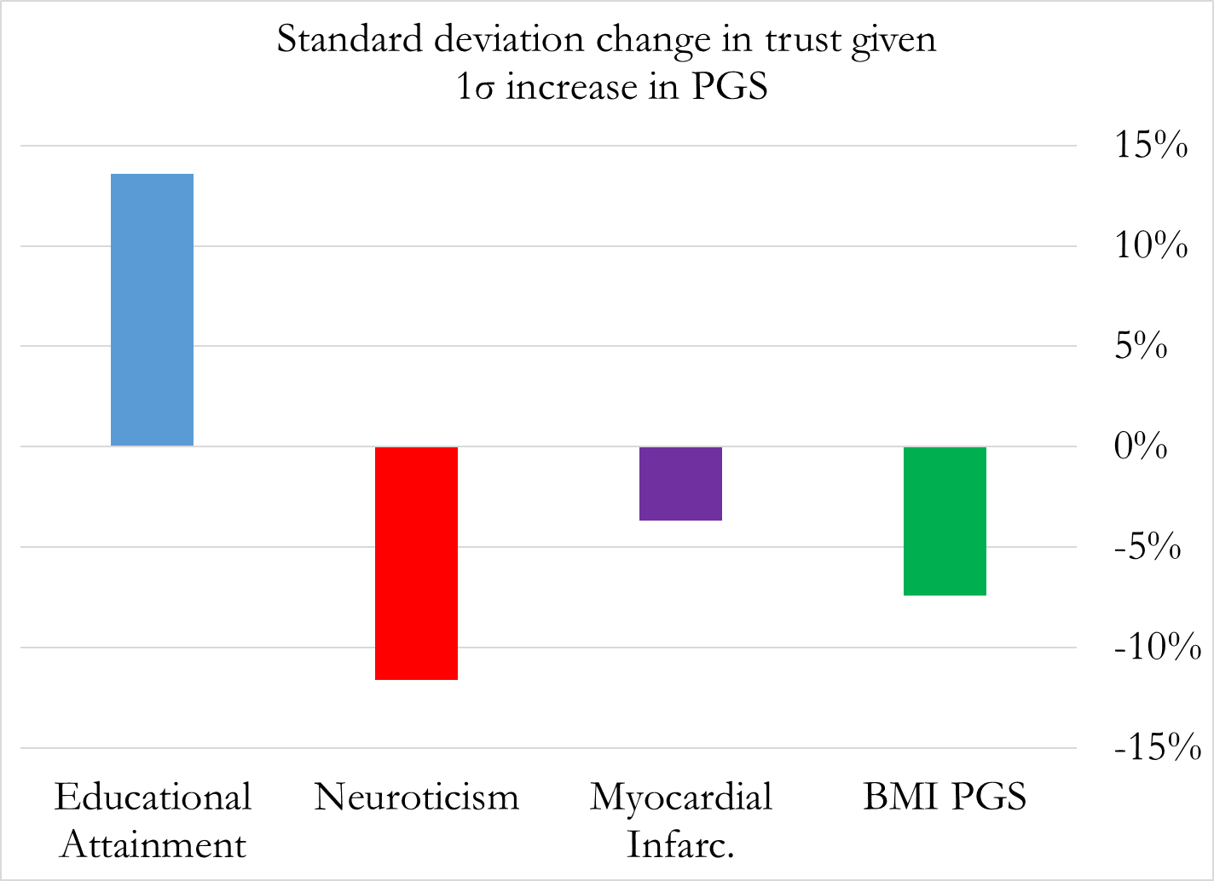
Genetics and trust

Slide 23
Traditional explanatory variables and genetics
Q3b – How much of the relation between outcomes and traditional variables is due to genetic variation in traditional variable versus non-genetic variation?
Step 1: Remove variation in outcomes and traditional variables attributed to the control variables: “Orthogonalized” participation, risk aversion, beliefs, trust
Step 2: Regress orthogonalized trust on the eight PGSs
➔fitted value is “genetic component”
➔residual is “non-genetic component”
Step 3: Regress orthogonalized participation on genetic and non-genetic components of trust and partition R².

Slide 24
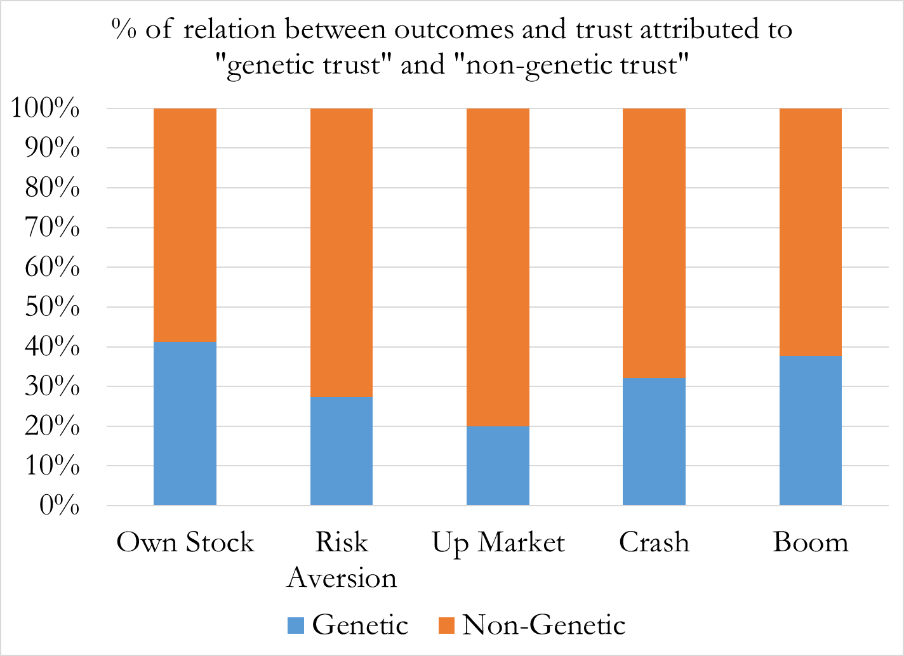
Genetics and trust

Slide 25
Traditional explanatory variables and genetics
Q3 – Can genetics help explain the relation between “traditional” explanatory variables stock market participation, risk aversion, and beliefs? And if so, how much?
Yes
Across 11 variables ~ 40% genetic/60% non-genetic

Slide 26
Summing up…
Genetic endowments associated with cognition, personality, health and body shape help explain variation in:
Risk aversion
Beliefs re the distribution of stock returns
Owning stock
About 30% of the relation between stock ownership and risk aversion and beliefs arises from the portion of risk aversion and beliefs explained by these eight genetic endowments
About 40% of the relation between stock ownership and traditional explanatory variables arises from the “genetic” component (across the 11 variables)

Slide 27
Thank You!

